Slide 1
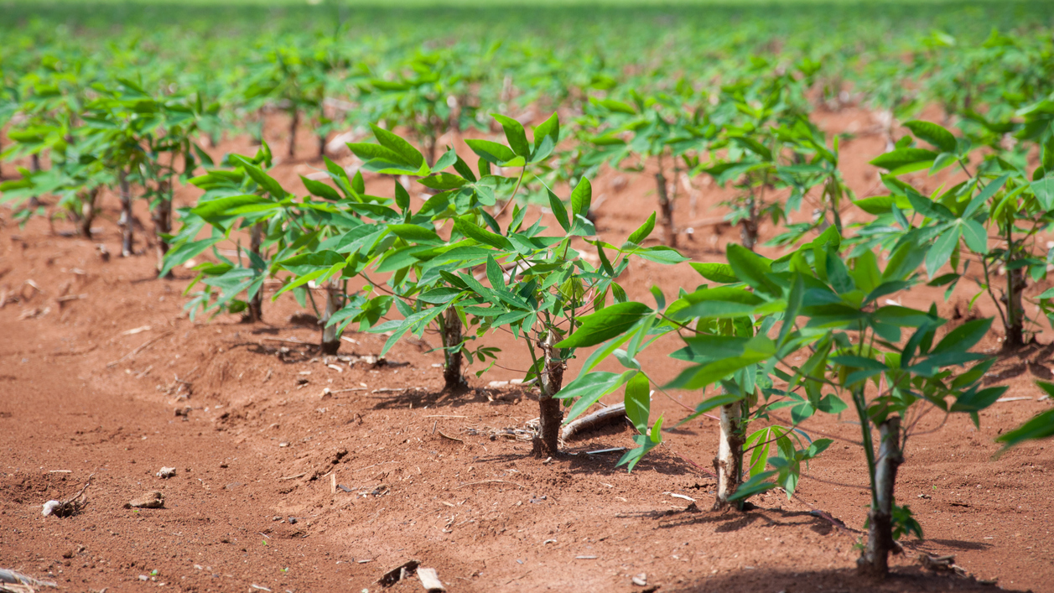
Identify Type of Disease from Image of Cassava Leaves with Deep Learning Methods
Hanlin Tang, Yuechuan Chen, Hua Tong
This Photo by Unknown Author is licensed under CC BY-NC-ND

Slide 2
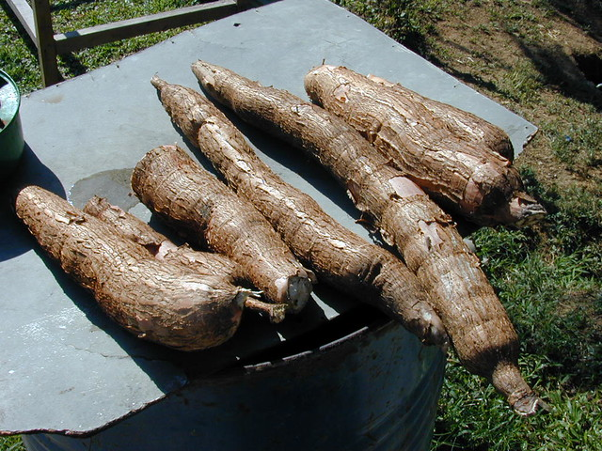
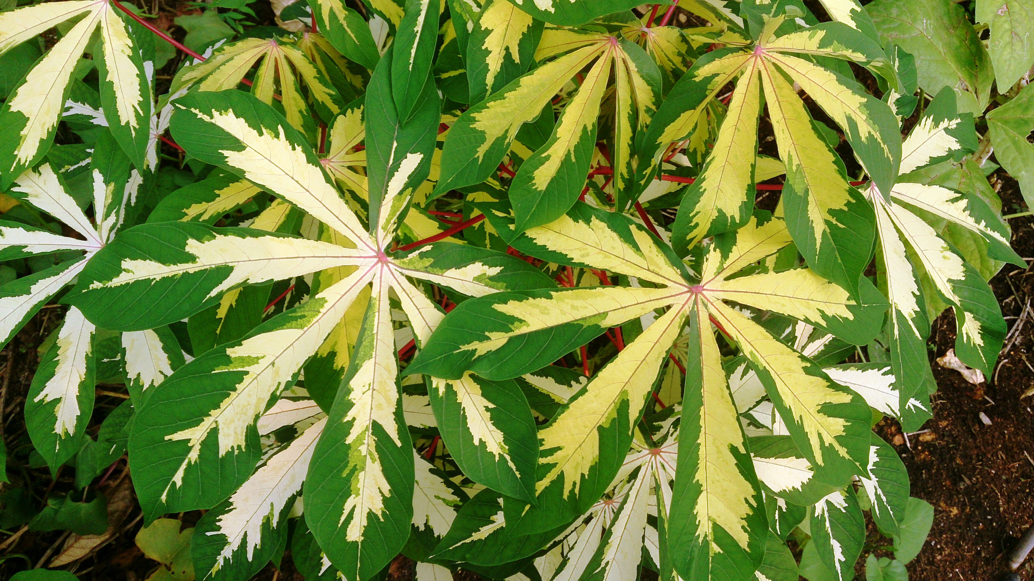
Contents
Background and Motivation
Methods and Models
Experiment Details
Result and Summary

Slide 3
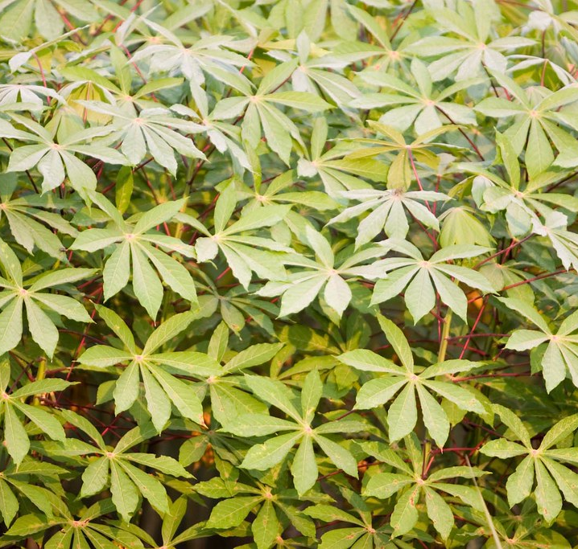
Background and Motivation

Slide 4
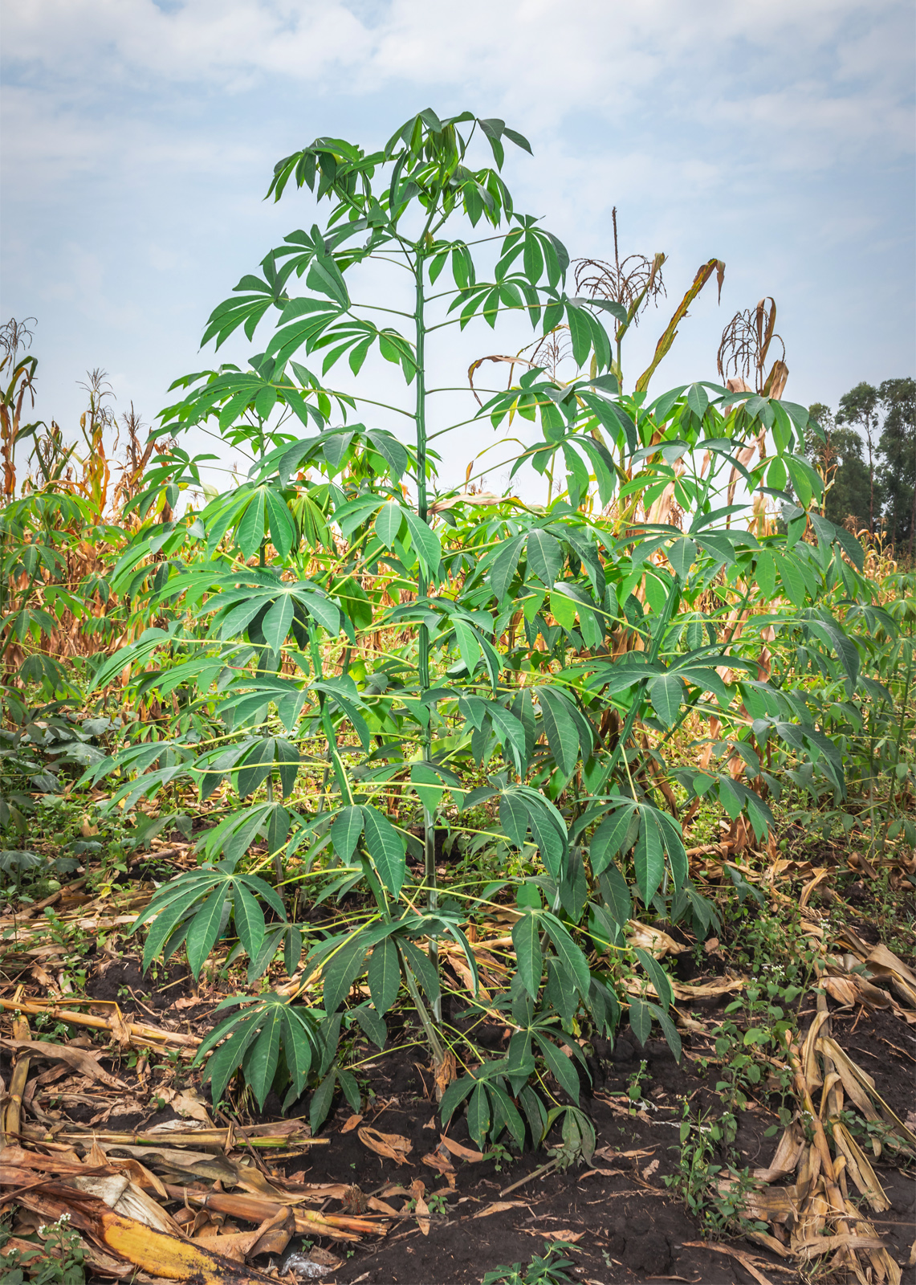

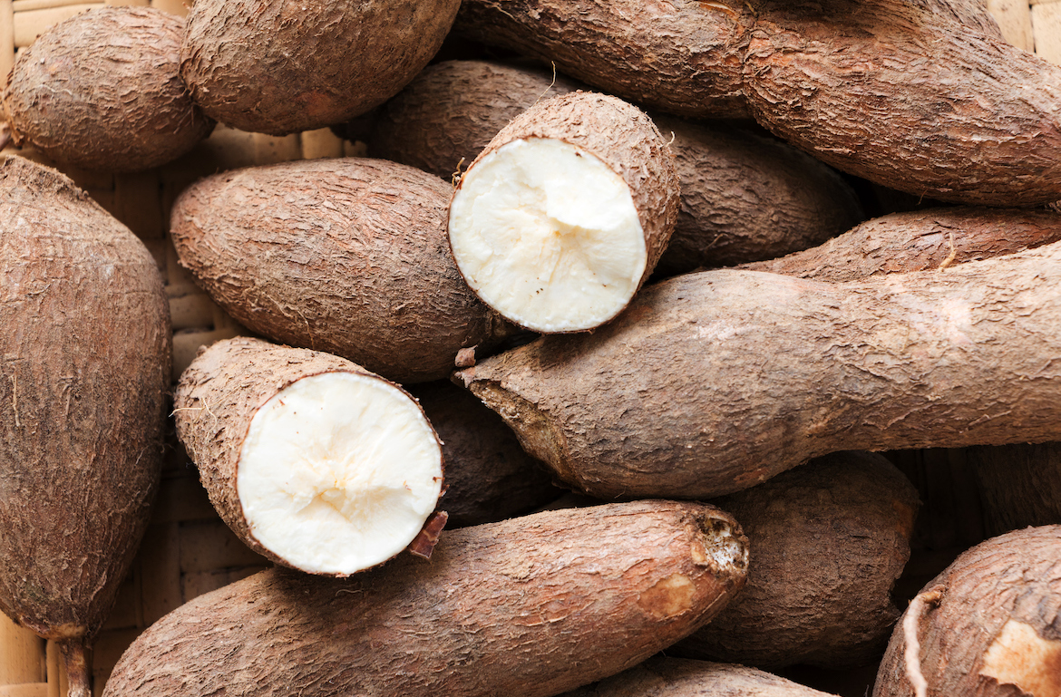
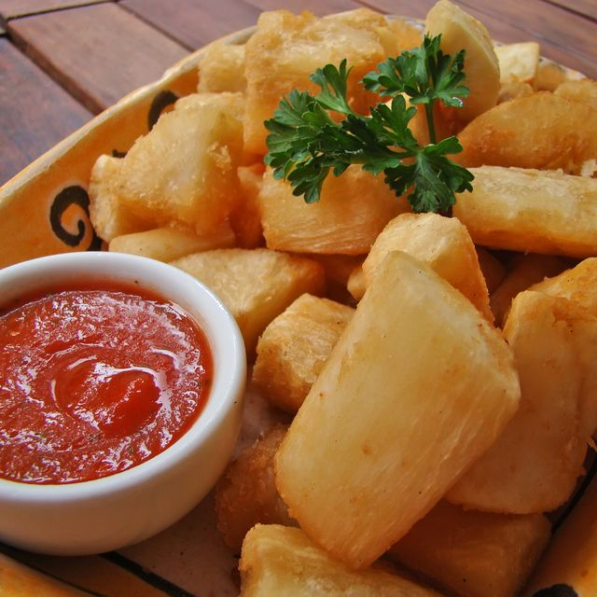
Background
Cassava, a major staple food in the developing world that plays a vital role in saving the world from hunger.
At least 80% of household farms in Sub-Saharan Africa grow it.
However, there are viral diseases that preventing good yields.

Slide 5
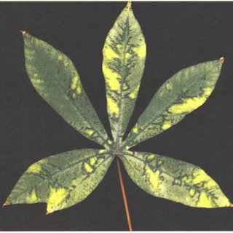
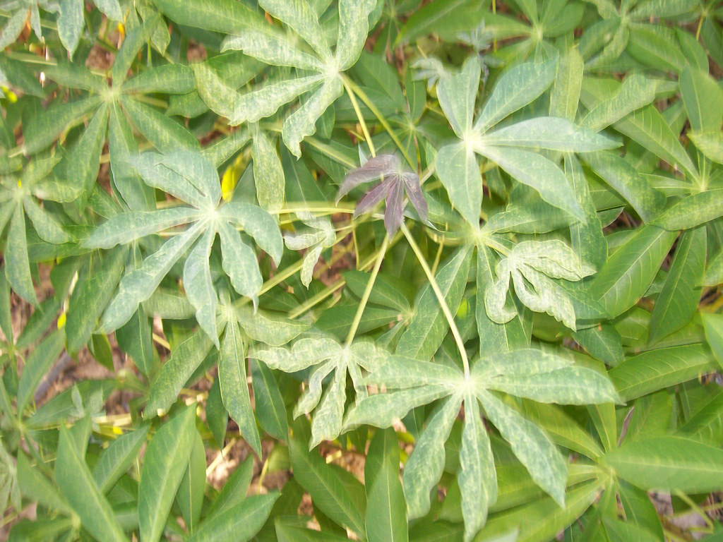
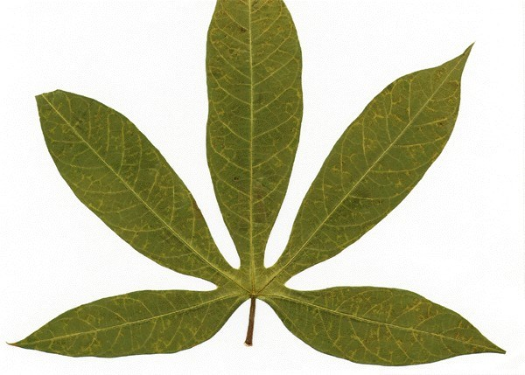
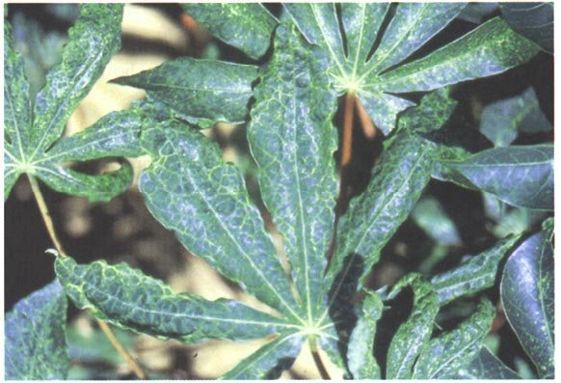
Diseases
Cassava Bacterial Blight (CBB)
Cassava Brown Streak Disease (CBSD)
Cassava Green Mottle (CGM)
Cassava Mosaic Disease (CMD)

Slide 6
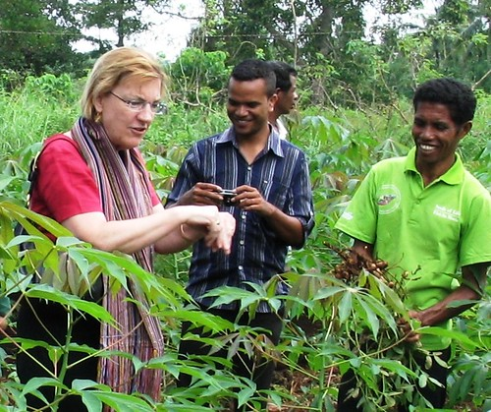
Motivation
Existing detection methods require the involvement of experts’ inspection, which suffers from being labor-intensive, costly, and sometime inaccessible.
Meanwhile, find out the infected plants sooner could help stopping it from spreading.
Thus, “identifying disease with image” comes to be an option.

Slide 7
Methods and Models
This Photo by Unknown Author is licensed under CC BY

Slide 8
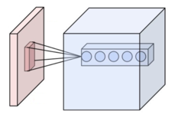
Models
Convolutional Neural Network
AlexNet
VGGNet
ResNet
GoogLeNet
ResNeXt
Wide ResNet

Slide 9
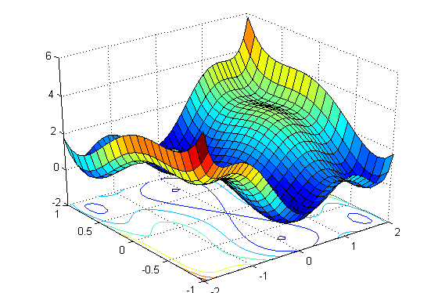
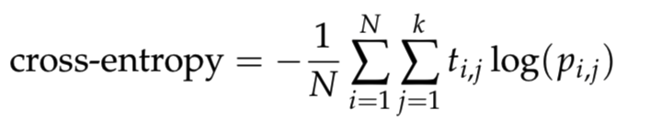
Loss function
Cross-entropy

Slide 10
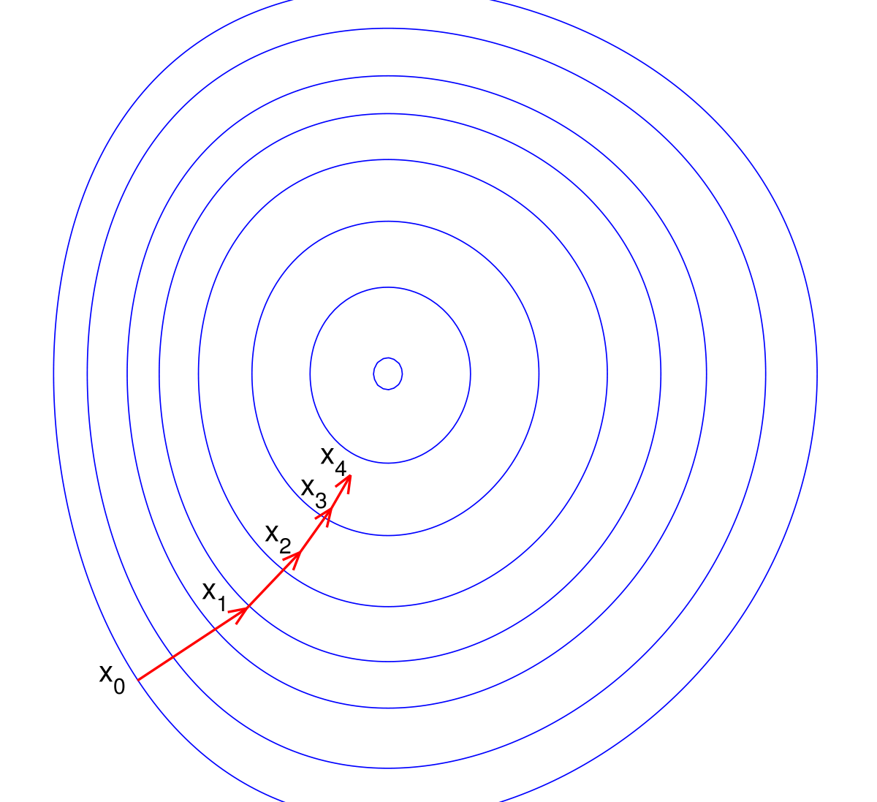
Optimizing
Stochastic gradient descent
Originally referred to the optimizing strategy that update parameters for each single sample.
Nowadays it is more often referred to the mini-batch gradient descent, which take a mini-batch instead of single sample.
This Photo by Unknown Author is licensed under CC BY-SA
此照片，作者: 未知作者，许可证: CC BY-NC-ND

Slide 11
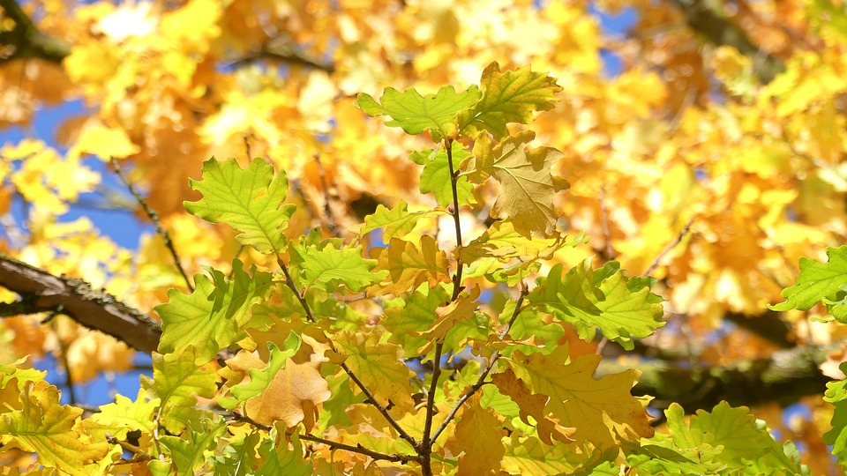
Optimizing
Adaptive Moment Estimationan (Adam)
Algorithm for first-order gradient-based optimization of stochastic objective functions, based on adaptive estimates of lower-order moments.
The method is straightforward to implement, is computationally efficient, has little memory requirements, is invariant to diagonal rescaling of the gradients, and is well suited for problems that are large in terms of data and/or parameters.
此照片，作者: 未知作者，许可证: CC BY-NC-ND

Slide 12

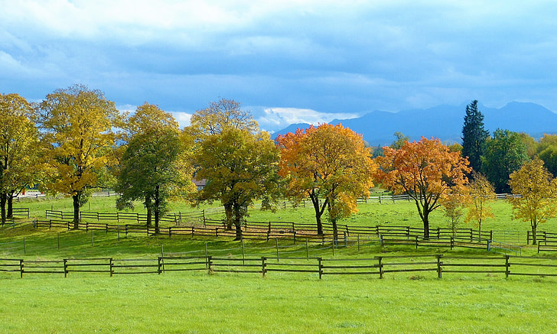
Optimizing
Early Stopping
Early stopping, as the name stating, is to stop training earlier than our pre-determined epoch number. There are many criteria for doing early stopping, while most of them are based on the validation accuracy.
We designed such an early stopping strategy: “Stop if the max validation accuracy does not increase for 6 epochs, or does not increase for 2 epochs while train accuracy is larger than 99%.”

Slide 13
Experiment Details
This Photo by Unknown Author is licensed under CC BY

Slide 14

Data Set
Numbers
Each Data
80% training data (17118)
5% validation data (1070)
15% test data (3209)
Around 15000 online test data (not visible)
An RGB 3 channel, 800x600 image
During initial training, we resize to 400x300 for efficiency
For pretrained models, we normalize with mean [0.485, 0.456, 0.406] and std [0.229, 0.224,0.225]

Slide 15



Environment
Software
Hardware
Pytorch on python, including it’s embedded models (torchvision.models).
Overleaf for report, and Powerpoint for slides.
One GTX 1650, one RTX 2080, and one RTX 2080 Ti.

Slide 16

General procedure
Initial tuning
fine-tuning
Load model from pytorch package
Train at most 40 epochs with the early stopping setting
Generally, use SGD with 0.001 learning rate or 0.0001 learning rate, depends on the result.
Only tried on Resnet due to lack of resources.
Make necessary change to the architecture
Manually adjust learning rate
Run less epoch each time and keep improving

Slide 17
Result and Summary
This Photo by Unknown Author is licensed under CC BY

Slide 18


Accuracy
 | Training acc | Validation acc | Local test acc | Online test acc
AlexNet | 83.07 % | 82.43 % | 79.37 % | 78.21 %
VGG16 | 98.18 % | 88.13 % | 85.63 % | 84.72 %
Resnet34 | 99.99 % | 84.58 % | 82.08 % | 80.55 %
GoogLeNet | 98.59 % | 84.30 % | 82.61 % | 82.48 %
ResNext | 98.26 % | 86.73 % | 85.76 % | 84.37 %
WideResnet | 95.86 % | 86.17 % | 84.11 % | 83.78 %

Slide 19
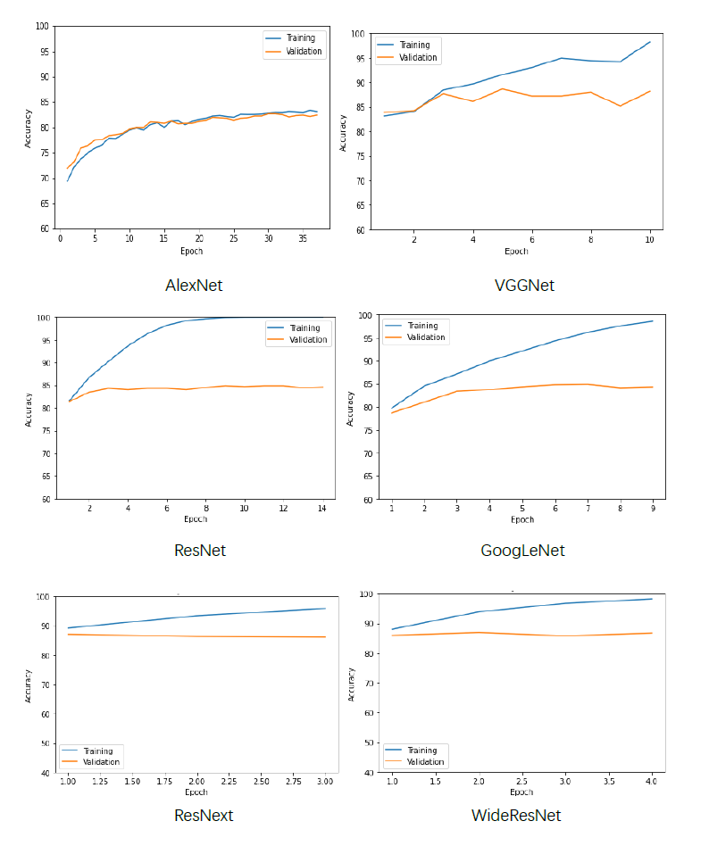
Training Accuracy

Slide 20
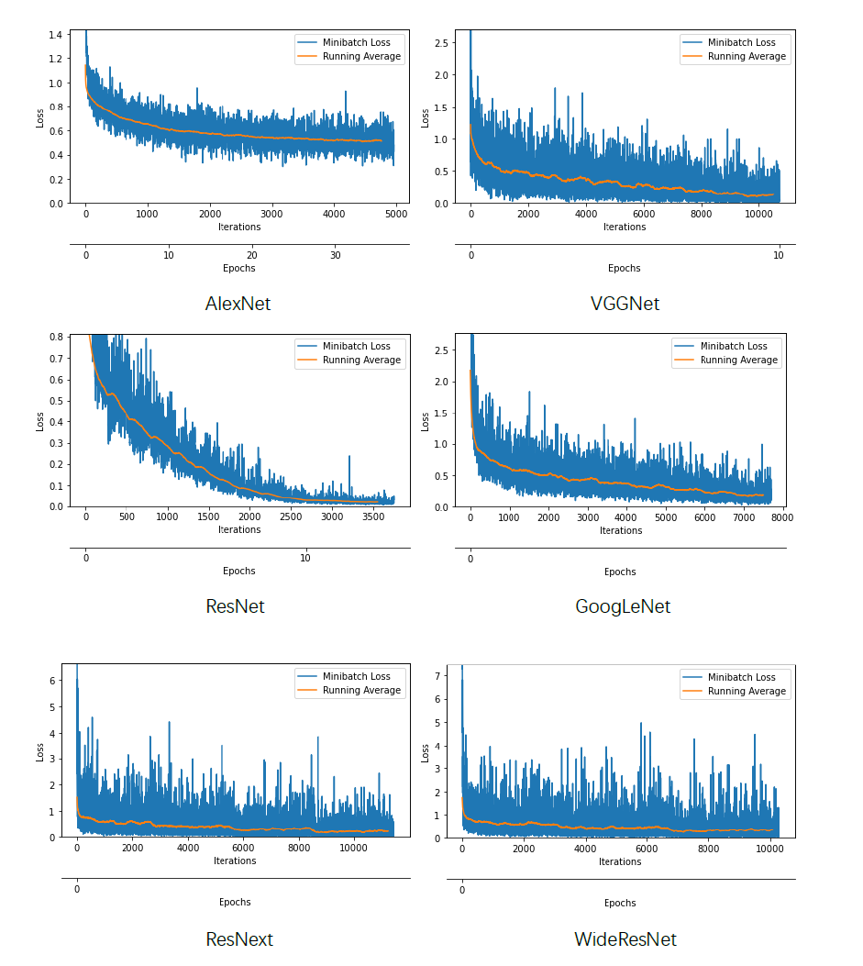
Mini-batch Loss

Slide 21
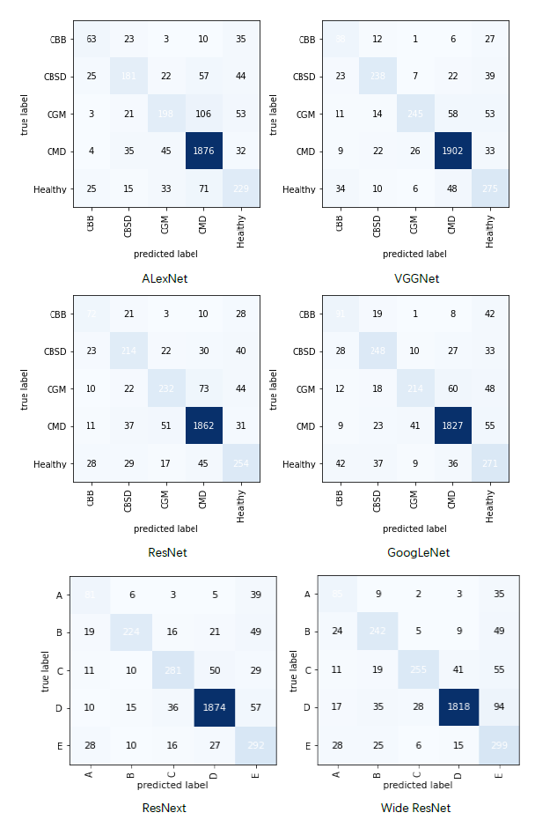
Confusion matrix

Slide 22

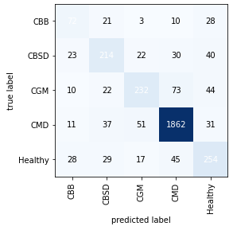
Fine-tuning model
Process
Due to the limitation of time and resource, we only managed to fine-tuning one model: Resnet.
Input resized to 512x512 instead of 400x300
Start with pretrained model
Replace the last fc layer (2048,1000) with fc (2048,5).
Trained with smaller mini-batch (8 instead of 16)
After each epoch, manually decrease learning rate on acc fluctuating
Eventually run 6 epochs
Result
Train acc: 91.15 %, validation acc: 88.60 %
Test acc: 87.19%, online test acc: 86.75 %

Slide 23
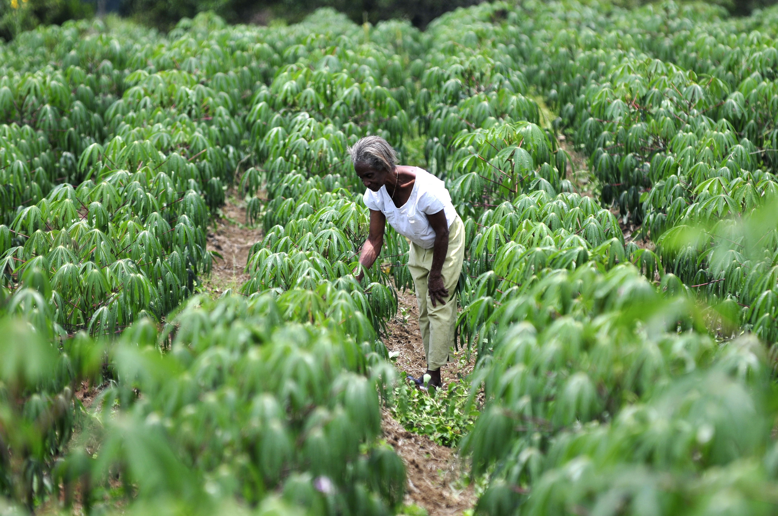
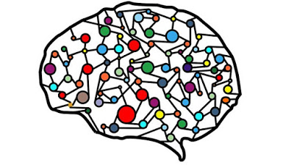
Summary
We practiced our skills in deep learning and meet the target we set at the beginning of the project.
We also learned the complexity of tuning and how cost it could be to run deep learning training.
The final result, though not outstanding, is very much usable and helpful.
Yet, more fine-tuning is expected if time and resource allowed.

Slide 24
Thank You
Hanlin Tang, htang79@wisc.edu
Yuechuan Chen, ychen959@wisc.edu
Hua Tong, htong24@wisc.edu
Github: https://github.com/Tonghua35/453-Final-Project

